Slide 1
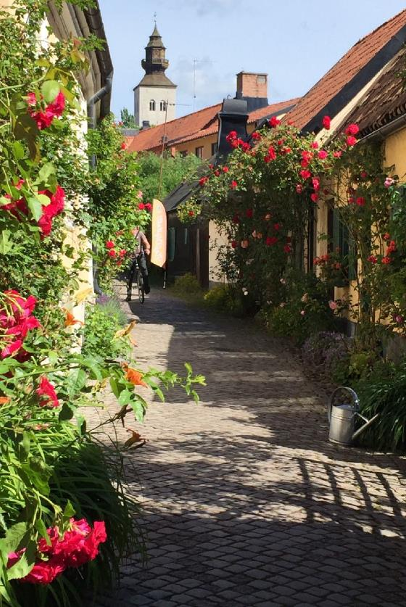
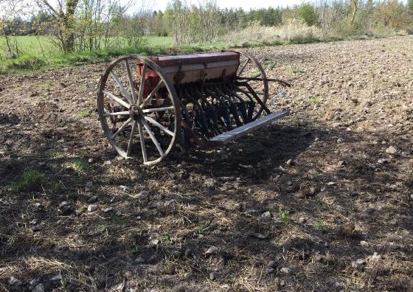
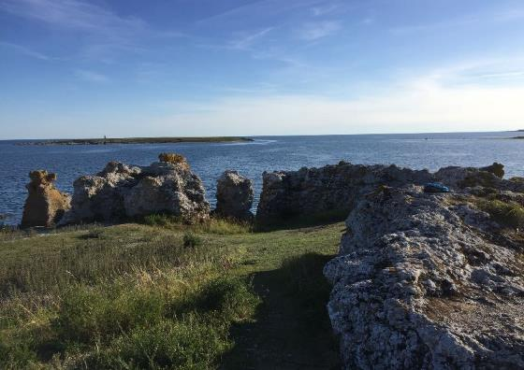

Slide 2
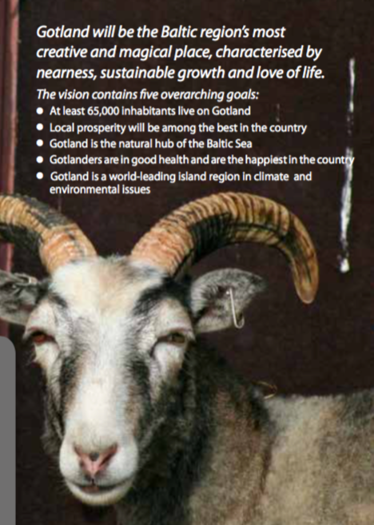
Gotland
From An Analogue Past Towards
A Digital Future

Slide 3
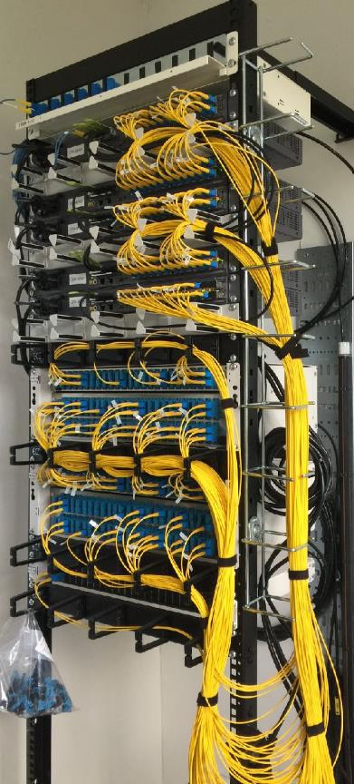
What we have achieved
How have we done it
What did it cost
Our next step
Send-off

Slide 4
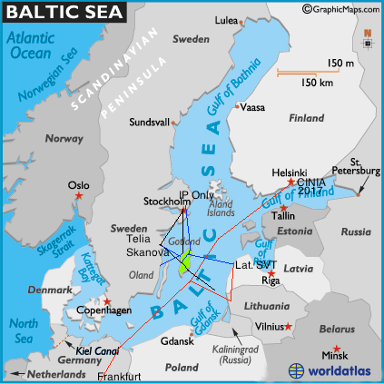
Gotland: 180 km x 50 km
57 498 inhabitants
60% outside of Visby
slight population growth
seasonal residens increase
growing slightly older - faster
Distance from Visby to:
Stockholm 189 km
Riga 358 km
Helsinki 475 km

Slide 5
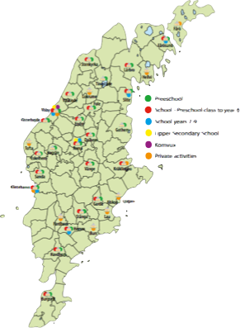
other aspects of Gotland…
>90% workplaces fewer than 5
tax-capacity 87% of national average
agriculture - food industry (28%), quarrying, tourism, event- & creative industry
Uppsala University Campus Gotlands
2 million travelers
approaching 1 milj overnight guests
23500 houses in rural areas
out of which 9000 are “seasonal houses”
and Visby
9800 companies and 4500 family businesses
92 parishes
almost each with a fiber node
EDUCATION
OUR MAIN TARGET
OUR AREA to cover

Slide 6
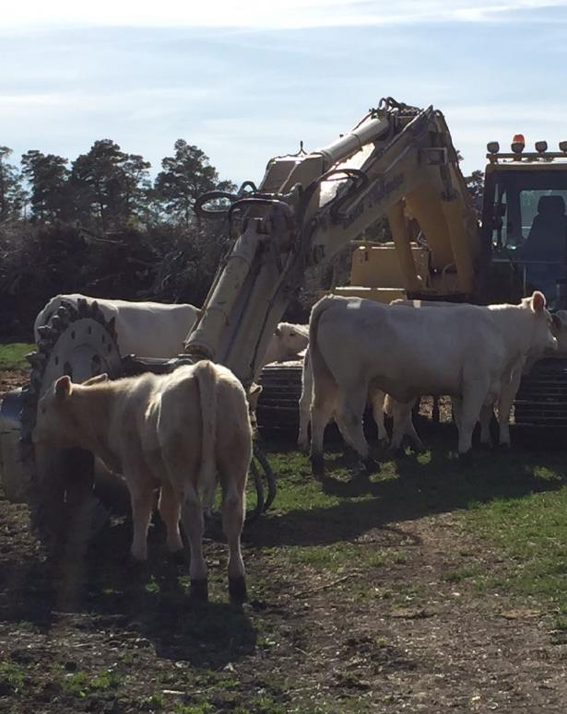
What we have achieved
How have we done it
What did it cost
Our next step
Send-off

Slide 7
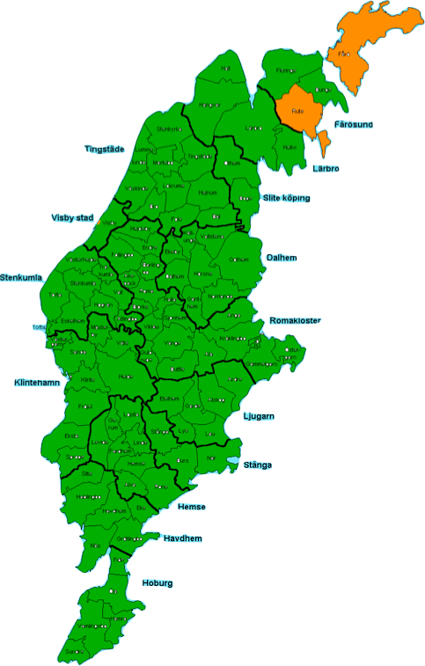
Optic fiber roll-out on Gotland Report date 2016-10-19
Optic-fibre access:
90(92) parishes finished
+ Visby beyond the walls
～90% of the population has access to fiber
Technically no capacity limits …
2010… 100/10 3Play
2015… 250/100 Mbps < 4 or 12 Gbps
Back-bone dimensioned to = present + 20%
No "white spots"
Completion estimated by Q4 2016
Penetration rate:
Permanent residents 80 - 99%
Seasonal residents 55 - 99 %
In Visby (permanent residents) 55 - 85 %
Age group + 65 have joined
35 - 45 less so
Q3 2016

Slide 8
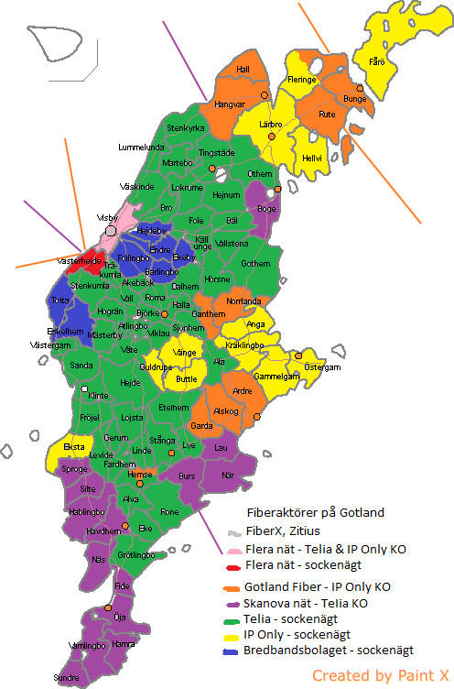
We believe in market competition
- when we can get it….
Networks owners:
31 parishes + 5 commercial actors
+ a wide variety of network and service providers
3Play from monthly € 35
on-off subscription for seasonal residents
Architecture:
Central design, scalable, resilient and robust,
latest standards
UPS 2+2 4 hours in node
+ diesel if needed
UPS in homes
Networks automatically switched towards mainland
Redundant fiber-loops between parishes

Slide 9
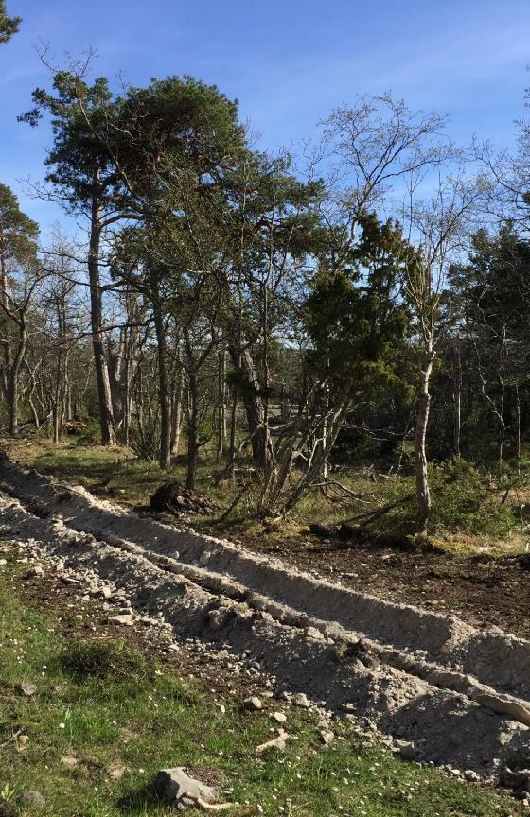
What we have achieved
How have we done it
What did it cost
Our next step
Send-off

Slide 10
Gotlands Digital Road - County & Region Together
2009 Scanning the market - 2 pilots in Skanova´s fiber-to-the-farm
2010 Broadband Strategy Unanimously adopted — Fiber to ALL
4 parishes start digging - Telia deliver services > 85% joins
2011 Diploma for our ambitions - but lack of fiber
Local ”umbrella organisation” for parish networks
Skanova Open Net
2012 Bredbandsbolaget
2013 IP Only / Gotland Fiber
2014 Micro-trenching
Visby is waking-up
The island join to map out the Regional Digital Agenda
2015 Regional Digital Agenda (RDA) Unanimously adopted
Gotland top-ranking rural fiber-roll-out
FiberX /Visby Stadsnät with Zitius in old town Visby
2016 Gotland top-ranking > fastest mobile network
RDA: 21 out of 76 projects ✓ and 8 new added
Optic-fiber digging - Completed

Slide 11
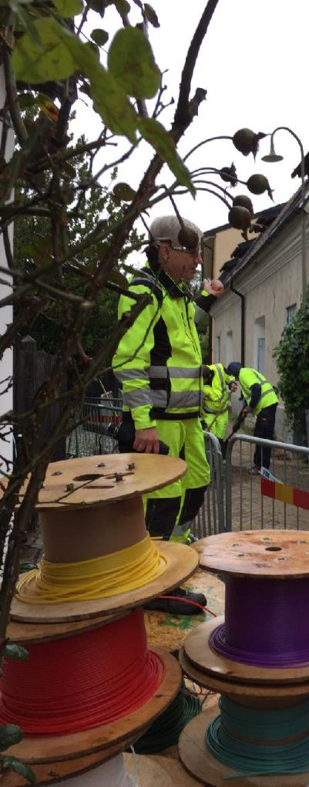
What we have achieved
How have we done it
What did it cost
Our next step
Send-off

Slide 12
Estimated total production cost
Fiber roll-out ～ 55 milj €
Estimated total financing
Outside of Visby
Average cost for digging 3.5 - 5.50 € / meter
Total production cost at 8 - 10 € / meter
Public support, if not commercially built 200 € / house
Renting local fiber (6-10years) 450 € / house
Average production cost 2500 € / house
Average direct investment 1650 € / house
Financial support ”fiber-loan” negotiated with local banks

Slide 13
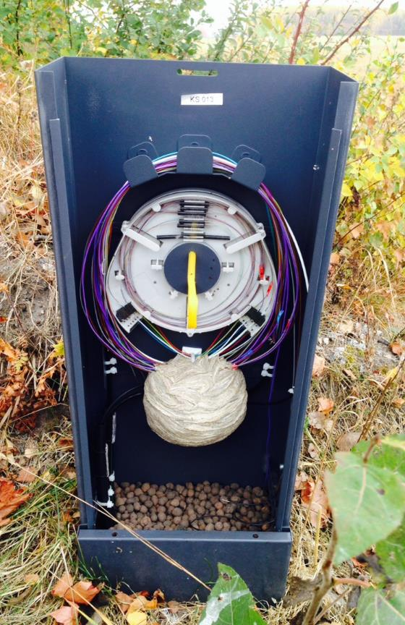
What we have achieved
How have we done it
What did it cost
Our next step
Send-off

Slide 14
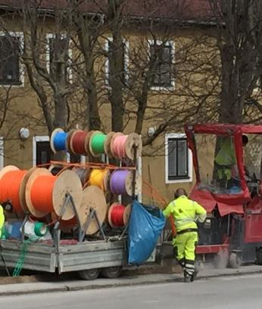
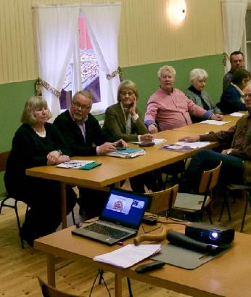
2015
The County Council & Region Gotland adopts Gotlands Regional Digital Agenda (RDA)
Digital business development
e-services - mainly in the public sector
Broadband, mobile networks, WiFi and robust networks
Increasing the public interest in and use of IT
e-health
Digital GIS to support public services and democratization
Digital education - from pre-school to University
76 targeted goals aiming at utilizing the fiber roll-out.
2016
Uppsala University Campus Gotland program ”Digital Analysis”
Entrepreneurs start to show interest in digital Gotland:
Pilot-projects (many elderly on-line is our bonus)
healthcare, social services, services for elderly,
handicapped, immigrants, entertainment…
RDA: 21 out of 76 projects ✓ … 8 new added
2017 - 2020
Implementing the Regional Digital Agenda
Find new partners, business and regions, to help us develop digital Gotland
NEW

Slide 15
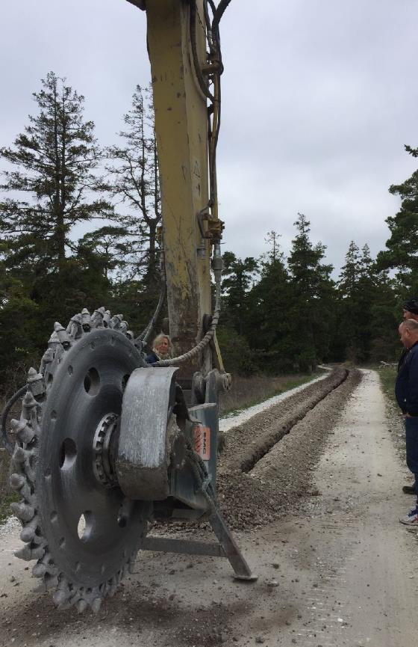
What we have achieved
How have we done it
What did it cost
Our next step
Send-off

Slide 16
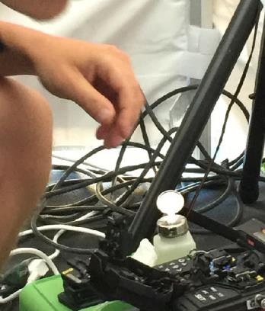
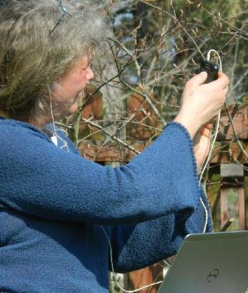
Key-factors for our success
Political agreement - Local co-operation pave-the-way
Coordinator <> masterplan - facilitator - cheer-leader
Why fiber ? <> Efforts on market penetration !
Over 50% joining lower costs very significantly
Motivates market to build in your remote regions
Motivates users to look forward to the digitalization
Key-issues we think need attention …
Forget asymmetric capacity!
Digitalization need robust and resilient systems
New legislation prevents deployment of extra canalizations

Slide 17
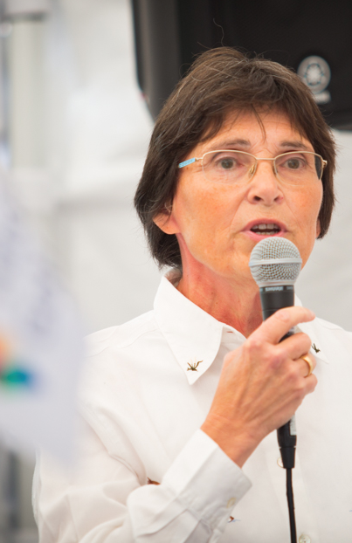
You have been listening to:
Anne Mousa Ståhl
Coordinator of Broadband roll-out and the
implementation of Gotlands Regional Digital Agenda
Region Gotland
62181 Visby, Sweden
+46 722 27 33 33
anne.stahl-mousa@gotland.se
www.bredbandgotland.se
www.digitalagotland.se

