Slide 1



The Baltic Sea Area – fortrunner in digitalization!
Brussels 16.11.2016
Innovative regional solutions
Case: Portable Sensor Management for Reliable Condition Measurement
Jari Soini
Tampere University of Technology (TUT)
Pori, Finland

Slide 2
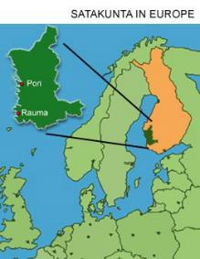
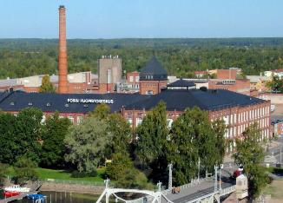

Satakunta region / West Finland
UNIVERSITY CONSORTIUM OF PORI
Campus - North bank of the river Kokemäenjoki
4 Universities, 2242 Students, 177 Personnel (2015)
Satakunta region
ca. 223 000 inhabitants (Finland ~5.5 million)
Main industries
  Forest-based, Metal, Chemicals
ca. 1 000 people in ICT
ca. 40 software companies
  Most have fewer than 50 employees (mostly 1-10)
City of Pori
  founded in 1558
  residents: 85 226 (2015)
  surface area: 1 704.06 km²
  the biggest employer in the area
Finland
Brussel

Slide 3
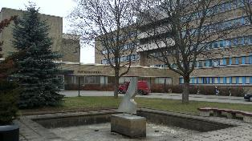

Case: Portable Sensor Management for Reliable Condition Measurement
Project target:
Health Center of the city of Pori
Research focus:
Reliable verification and illustrative
presentation of changes in property
conditions
Implemented by:
  Tampere University of Technology (Academic partner / project coordinator), The City of Pori (Public sector partner), Riffid Ltd and SWOcean Ltd (Private sector partners)
  Finnish Funding Agency for Technology and Innovation (Tekes)

Slide 4

Innovative aspects
The ultimate goal was to develop a solution that was:
  Transferable from one point to another
  Scalable (addition of sensors) at a later date
  Visualizable for analyzing and interpreting the collected data (clear presentation of measurement results)

Slide 5
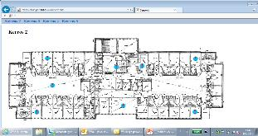


Solution: Portable Sensor System
32 RFID/NFC sensors (8 per floor) for temperature (C) and relative humidity (RH) measurement
measurement frequency: every 15 mins
NFC reader
RFID/NFC capable sensor
Wireless data transfer
Low energy consumption
Long operating period (about 2 years)
Capacity 16000 data points
Overview of the system
Measurement data
internet

Slide 6
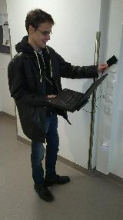
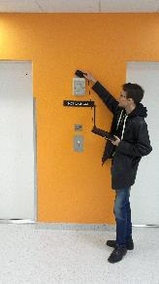
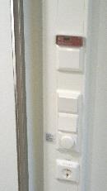
Collecting the sensor data

Slide 7

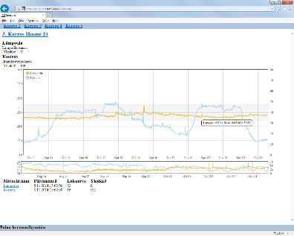
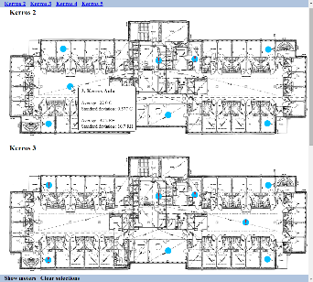

Presenting the sensor data (Web UI)
Data analyzers
2 weeks

Slide 8
Summary
Tangible benefits of the system:
  Property automation functionality and its deviations reliably indicated
  Locating problem points -> property automation control
  Illustrative and location-independent (web service) sensor data presentation
  Transferable and scalable and cost-efficient (no wiring needed, easy to add sensors)
  Promotes well-being of employees (improved working conditions)
  Reduces patient/nurse debate related to temperature variation (cold/hot) in the building/patients’ rooms
  Acts as a thermometer (LCD screen)

Slide 9




TUT Pori, Research groups
Professor
Hannu
Jaakkola
Assistant
Professor
Sami
Hyrynsalmi
Research
Manager
*Jari Soini
BENI - Business ecosystems, networks and innovations
SEIntS - Software engineering and intelligent systems
TRC - Telecommunication Research Center
TUT Game Lab - Learning games and gaming in education
DAO - Data analytics and optimization
SEIntS - Software engineering and intelligent systems
Global software engineering
Software business
Software engineering management
Software product management
Software and application architectures
Web services and user interface techniques
Mobile and web applications
Sensors and sensor networks
Embedded systems
Digitalization in society
Gamification*

Slide 10
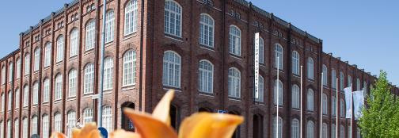
Thank you for your attention
… looking forward to you cooperating with TUT Pori !
Jari Soini
Research Manager (Dr. Tech.)
Tampere University of technology, Pori, Finland
jari.o.soini@tut.fi

