Slide 1
Bottom‐up!
A faster track in constructing cost‐effective rural networks with high penetration
Philip Donner
Village Network Cooperative of North-Western Kuhmo
iBSG Seminar, 16.11.2016 at Arts, Brussels

Slide 2
The challenging context
Kuhmo town, in mid-eastern Finland at the Russian border
Low population density and long distances
Skewed age distribution: many elderly and few young ones
Mixed economy in transition:
forestry, milk and beef cattle farms
Services concentrated in the urban center
Local resources
Network of village societies, village property
Buildings with rooms suitable for network installations
Knowledge in local geography
Readiness to do voluntary cooperative work, 'talkoo'
Earthwork construction skills, shovel machines

Slide 3
Aims
Improve living conditions of inhabitants and working conditions of companies
Equal and accessible public services over Internet and high speed Intranet
Activate the local population and provide business opportunities for local earthwork companies
Provide infrastructure for two-way, low-latency audiovisual communication

Slide 4
Strategy
Well-functioning and sustainable optical fiber networks
Neighborhood model: Bottom-up oriented activation
Network construction is no rocket science (80% earthwork)
Everyone wants to subscribe to the self-constructed net
Infrastructure for services are based on tools, which resemble telephones and TV-sets, but which are much easier to use

Slide 5
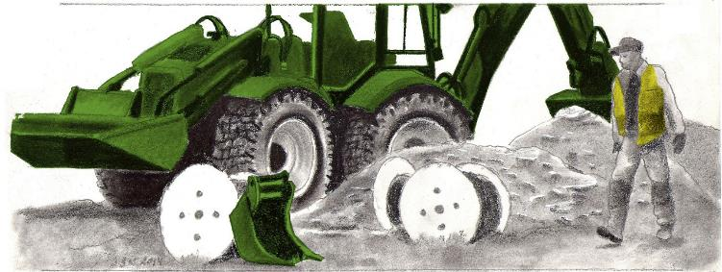
Achievements
204 members of cooperative, 224 subscriber lines
150 km core networks in 6 weeks (timing, local constructors)
36 500 hours voluntary input (1 machine hour = 2 human work hours)
Low cost construction: 6-7 €/m core network routes, 2-3 €/m for subscriber lines
High penetration rate (60% cf. 15-25% in telecom projects)

Slide 6
Advantages
100 € cooperative share, 500 € / subscriber line
Low monthly fee 28 € / month (for a 100/100 Mbps Internet and 1/1 Gbps Intranet connection)
Network owned by cooperative members
Conclusion
The information society should be based on an optofiber network infrastructure. This can be built cost-effectively as village networks in a self-reliant bottom-up oriented manner: This is the best way to achieve a high penetration percentage, cost-effective construction and low subscriber fees. It also generates social cohesion, it stimulates local earthworks construction and generates tax income.

Slide 7
Philip Donner
Kokkovaarantie 1063
88760 Iivantiira
Finland
mailto:pdonner@znak.fi
+358-400404555
Graphical artwork by Juha Sven Korhonen

